Slide 1

Green Pace
Security Policy Presentation
Developer: Ashley Molina-Runez

Slide 2

OVERVIEW: DEFENSE IN DEPTH
Software development at Green Pace requires consistent implementation of secure principles to all developed applications. Consistent approaches and methodologies must be maintained through all policies that are uniformly defined, implemented, governed, and maintained over time.

Slide 3
THREATS MATRIX
Summary of the security risks identified during Project Two, organized by likelihood and priority to illustrate the highest-risk vulnerabilities and recommended focus areas for mitigation.
Likely STD-003-CPP-Guarantee sufficient storage for char. Data and null terminator STD-004-CPP- Do not pass null terminator char. Sequence to library function expecting a string STD-006-CPP-Do not dereference null pointers STD-009-CPP-Free dynamically located memory no longer needed STD-010-CPP-Do not perform or use out of bounds pointers or array subscripts CSP-001 – Validate Input Data CSP-005 – Default Deny CSP-006 – Principle of Least Privilege CSP-007 – Sanitize Data Sent to Other Systems | Priority STD-001-CPP- Do not modify string literals STD-002-CPP-Ensure operations for signed integers do not result in overflow STD-005-CPP- Only free memory dynamically allocated CSP-002 – Heed Compiler Warnings CSP-003 – Architect and Design for Security Principles CSP-008 – Defense in Depth CSP-009 – Use Effective QA Techniques CSP-010 – Adopt a Secure Coding Standard
Low priority STD-007-CPP-Detect & handle standard library errors STD-008-CPP-Do not perform assignments in selection statements CSP-004 – Keep It Simple | Unlikely None Identified. All threats were Assessed as either a medium Or high likelihood of occurring if secure coding practices are not

Slide 4
10 PRINCIPLES
Validate Input Data: STR31-CPP, STR32-CPP, INT32-CPP
Heed Compiler Warnings: ERR33-CPP, MSC00-CPP
Architect and Design for Security Policies: MEM34-CPP
Keep it Simple: EXP50-CPP
Default Deny: ERR33-CPP
Sanitize Data Sent to Other Systems: STR02-CPP, STR31-CPP
Practice Defense in Depth: MEM50-CPP, ARR30-CPP
Use Effective Quality Assurance Techniques: MSC00-CPP
Adopt a Secure Coding Standard : All CERT C++ coding standards

Slide 5
CODING STANDARDS
STD-002-CPP- Data Value: Can lead to memory corruption, buffer overflows and exploitable vulnerabilities
STD-003-CPP- String Correctness: Prevents common buffer overflow attacks from insufficient storage
STD-004-CPP- SQL Injection: Improper string handling can lead to malformed input and security risks.
STD-010-CPP- Memory Safety: Out of bounds array access can cause crashes or arbitrary code execution.
STD-001-CPP- Data Type: Prevents undefined behavior by protecting string literals
STD-005-CPP- Memory Protection: Prevents heap corruption from invalid memory deallocation.
STD-006-CPP- Assertions: Prevents crashes and undefined behavior caused by null dereferences
STD-009-CPP- Memory Management: Prevents memory leaks and enhances long term stability
STD-007-CPP- Exceptions: Improves robustness through proper error handling
STD-008-CPP- Default Deny: Although important, this specific standard handles errors in conditional logic and statements. These are less likely to result in critical vulnerabilities seen with buffer overflow or memory corruption.

Slide 6
ENCRYPTION POLICIES
Encryption at rest : Green Pace shall encrypt all sensitive business and customer data using approved encryption algorithms while in storage. This applies to all production, testing, and backup environments when storing sensitive data. Explanation: Encryption at rest protects data in backups, file systems, and databases from unauthorized access if any software/hardware is compromised. This policy ensures information is protected from unauthorized access if any storage devices, software, or backups are compromised.
Encryption in Flight: Green Pace shall require the use of secure communication protocols such as TLS 1.3 and HTTPS for all network communications involving sensitive data. Encryption in flight protects data in transmission between users, applications, databases, and external systems. Encryption in flight prevents attackers from intercepting or modifying data during transmission and reduces the risk of man-in-the-middle attacks. This policy applies whenever data is transmitted across internal or external networks.
Encryption in Use: Green Pace shall implement memory protection controls, secure key management practices, and least-privilege access controls to minimize exposure of sensitive information while in use. Encryption keys shall never be hardcoded into applications and shall be stored in secure key management systems. Encryption in use protects sensitive information while it is being processed by applications and systems. This policy applies whenever sensitive information is loaded into memory or actively processed by an application.

Slide 7
TRIPLE-A POLICIES
Authentication: Green Pace shall require unique user accounts, strong password requirements, and multifactor authentication (MFA) for systems containing sensitive information. All user logins must be authenticated before access is granted. Authentication is the process of verifying the identity of a user before access to a system is granted. This policy helps ensure that only authorized individuals can access company resources and reduces the risk of unauthorized access.
Authorization: Green Pace shall implement role-based access control (RBAC) and the Principle of Least Privilege to ensure users receive only the permissions necessary to perform their job functions. User levels of access shall be reviewed regularly, and the addition of new users must be approved and assigned appropriate permissions before access is granted. Authorization determines what actions an authenticated user is permitted to perform within a system. This policy helps reduce the risk of privilege abuse and unauthorized access to sensitive resources.
Accounting: Green Pace shall maintain audit logs that record user logins, changes to databases, addition or removal of user accounts, access to sensitive files, and administrative actions. Logs shall be monitored regularly and retained according to company retention requirements. Accounting provides a record of user activity and system events for auditing and security monitoring purposes. This policy supports accountability, incident investigations, compliance requirements, and the detection of suspicious activity.

Slide 8
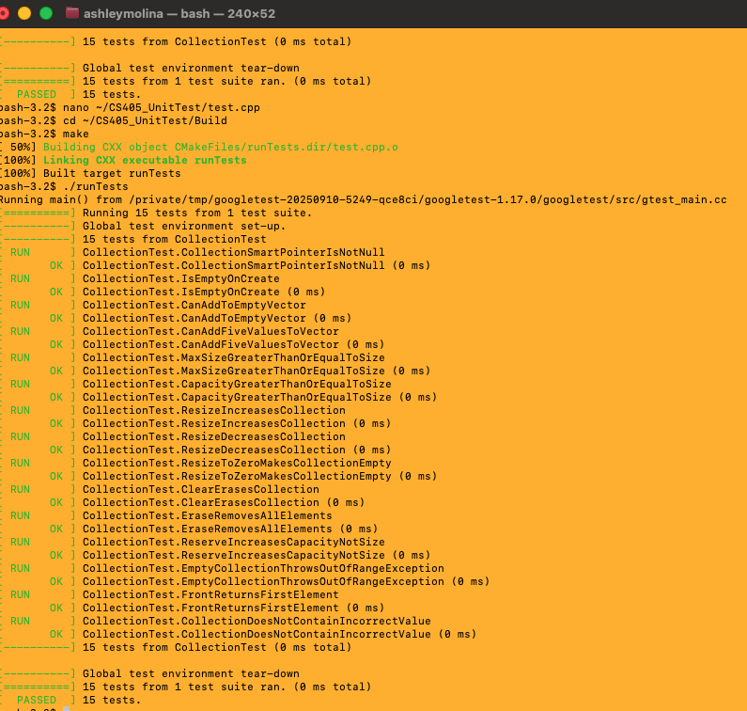
Unit Test 1: Does ClearCollection() remove all smart pointers from the collection?
Expected Result: Collection is empty after clearCollection()
Actual Result: Passed
Test Descriptions
Test #1: Positive tests prove that functionality works when tested. For example, Test(1+1) = 2.
Test # 2: Negative tests prove that an error or exception happens when provided bad data. For example, Test(5/0) => Divide By Zero.

Slide 9
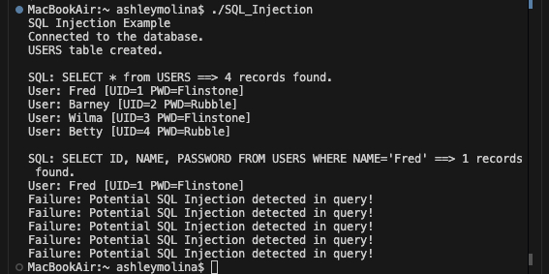
Unit Test 2: How do I modify the run_query function to detect a potential SQL Injection attack?
Expected Result: SQL Injection detected in Query
Actual Result: Passed
Test Description
Implement a Regex pattern that detects common SQL injection expressions before the query executes.
The Regex pattern searches for suspicious AND/OR conditions commonly used in SQL injection attacks, such as OR 1=1, OR 'a'='a', and OR 2=2. Once a potential injection pattern is detected, the program prevents the query from executing by returning false before the sqlite3_exec() function is called.

Slide 10
Unit Test 3: How do I detect and prevent numeric overflow or underflow when adding numbers?
Expected Result: adding numbers without overflow prevented and numbers with overflow detected
Actual Result: Passed - Without Overflow : False
With Overflow: true
Test Description
The numeric functions that will check for overflow or underflow before performing each addition or subtraction.
For adding numbers, the program compares the current result to std::numeric_limits<T>::max() – Increment`; for subtraction and then compares the current result to std::numeric_limits<T>::lowest() + decrement`. If the next operation goes outside of the valid range for that data type, the function sets a Boolean flag, stops the calculation, and returns the last safe result.
Screenshot of output on next slide

Slide 11
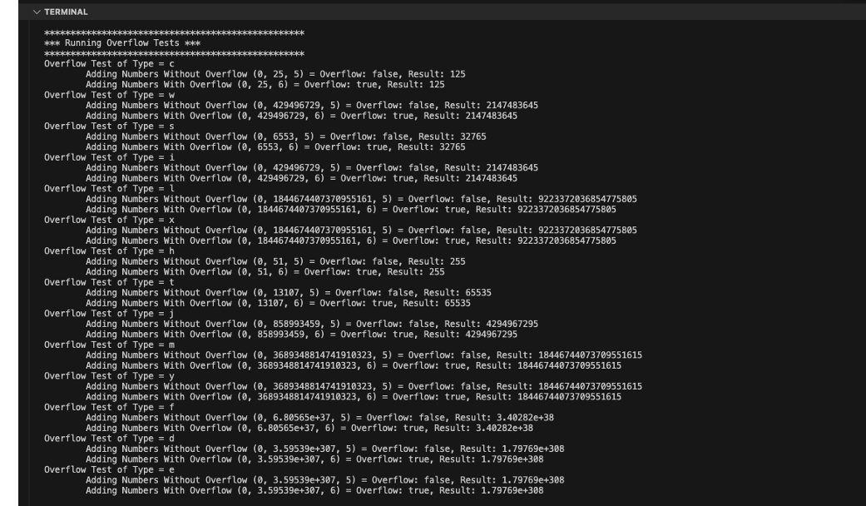
Unit Test 3: Screenshot

Slide 12
Unit Test 4: How do I detect and prevent numeric without underflow and with underflow when subtracting numbers?
Expected Result: subtracting numbers without underflow prevented and numbers with underflow detected with Result
Actual Result: Passed - Without underflow : False
Result: ####
With underflow: true
Result: #####
Test Description
The underflow test uses additional steps so the second subtraction test demonstrates underflow across the signed, unsigned, and floating-point data types. This prevents unsafe numeric wraparound while still showing the correct result when no overflow or underflow occurs.
Screenshot of output on next slide

Slide 13
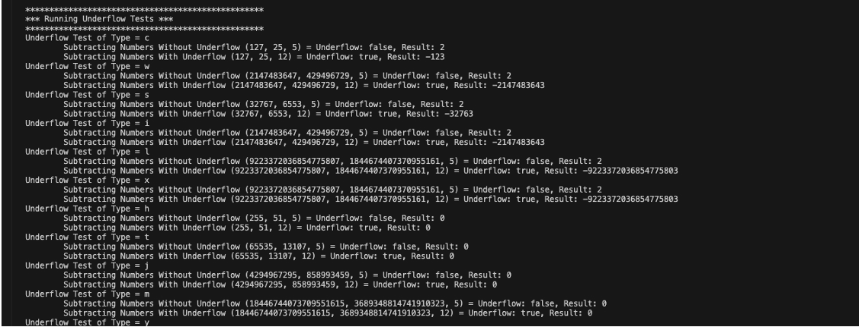
Unit Test 4: Screenshot

Slide 14

AUTOMATION SUMMARY

Slide 15
TOOLS
The DevSecOps pipeline integrates security throughout the entire software development lifecycle rather than waiting until development is complete. During the Assess and Plan phase, security requirements and potential risks are identified before development begins. The Design phase focuses on building secure software using established security principles and coding standards such as the CERT C++ Secure Coding Standard. During the Build phase, developers write secure code while automated tools such as CppCheck and SonarQube identify potential vulnerabilities. In the Verify and Test phase, the application undergoes functional, unit, and security testing to ensure vulnerabilities are identified before deployment. Once testing is complete, the application is securely deployed into production. After deployment, continuous monitoring detects suspicious activity and vulnerabilities, while the Respond and Maintain phase focuses on applying patches, recovering from incidents, and continuously improving the security of the application.
In the Build phase, automated static analysis tools such as SonarQube and Cppcheck should be integrated into the CI pipeline. All code commits and pull requests should be automated to trigger scans for violations of the coding standards for integer overflows, memory leaks, null pointer dereferences, buffer overflows, and unsafe string operations. Builds should automatically fail when critical or high-risk violations are detected. This will prevent vulnerable code from passing through the pipeline.
In the Verify and Test phase, the use of additional automated testing tools like AddressSanitizer and Valgrind should be used to identify memory leaks, runtime memory errors , and out-of-bounds array access. Automated unit tests are also recommended to validate proper error handling and secure application behavior. Security findings should be reviewed and corrected before deployment approval is granted.
In the Monitor and Detect phase, should continue to support compliance by collecting logs, monitoring application behavior, and identifying security events that may indicate coding standard violations or previously unknown vulnerabilities. By integrating automated security checks throughout the DevSecOps lifecycle, Green Pace can enforce secure coding practices continuously and ensure that security is addressed proactively rather than after vulnerabilities are discovered in production.

Slide 16
RISKS AND BENEFITS
Problems
Traditional software development often delays security testing until the end of the development lifecycle. This allows vulnerabilities such as integer overflows, buffer overflows, null pointer dereferences, memory leaks, and unsafe string handling to remain undetected until deployment, increasing both security risks and remediation costs.
Solutions
Integrating security throughout the DevSecOps pipeline addresses these risks by combining secure coding standards, automated static analysis tools such as CppCheck and SonarQube, runtime testing with AddressSanitizer and Valgrind, automated unit testing, and continuous monitoring after deployment. Vulnerabilities are detected and corrected much earlier in the development process.
Benefits of Acting Now
Implementing DevSecOps early reduces the likelihood of security incidents, lowers remediation costs, improves software quality, and prevents vulnerable code from reaching production. Early detection also shortens development cycles by resolving issues before deployment.
Risks of Waiting
Delaying security testing increases the likelihood that vulnerabilities will reach production, where they are significantly more expensive to correct. Organizations also face greater risks of data breaches, application downtime, regulatory penalties, and damage to customer trust.
Where the Strategy Is Lacking
Although DevSecOps provides strong automated security testing, it cannot detect every vulnerability. Business logic flaws, zero-day vulnerabilities, and sophisticated attacks may still require manual code reviews, penetration testing, threat modeling, and regular security training for developers.
Recommended Next Steps
Continue integrating automated security tools into the CI/CD pipeline, require security reviews before deployment, perform regular penetration testing, keep development tools updated, and provide ongoing secure coding training to development teams.

Slide 17
RECOMMENDATIONS
Current Gaps
The policy relies heavily on automated security tools but does not require manual code reviews or penetration testing.
Third-party software dependencies are not continuously monitored for known vulnerabilities.
Developer security training and recurring policy reviews are not formally required.
The policy does not include a documented incident response and recovery plan.
Future Improvements
Incorporate regular penetration testing and manual security reviews.
Implement automated dependency scanning using Software Composition Analysis (SCA) tools.
Require annual secure coding training based on the CERT C++ Secure Coding Standard and the OWASP Top 10.
Review and update the security policy annually to address emerging threats.
Develop and maintain a formal incident response plan.
Real-World Example
The 2020 SolarWinds supply chain attack demonstrated that organizations with strong internal security can still be compromised through vulnerable third-party software. Continuous dependency monitoring, secure software supply chain practices, and regular policy reviews help reduce these risks.

Slide 18
CONCLUSIONS
Green Pace should continue adopting industry best practices by:
Following the CERT C++ Secure Coding Standard throughout development.
Integrating automated security tools such as CppCheck, SonarQube, AddressSanitizer, and Valgrind into the CI/CD pipeline.
Performing standard manual code reviews and penetration testing.
Monitoring third-party software dependencies for newly discovered vulnerabilities.
Providing recurring secure coding training for developers based on the CERT C++ Secure Coding Standard and the OWASP Top 10.
Reviewing and updating the security policy annually to address emerging threats.
The 2020 SolarWinds supply chain attack demonstrated that secure coding alone is not enough. Organizations must continuously monitor software dependencies, strengthen supply chain security, and regularly update their security policies to reduce the risk of future attacks. By adopting these recommendations, Green Pace can improve software quality, reduce security risks, and better protect organizational and customer data.

Slide 19
REFERENCES
Molina-Runez, A. (2026). *Project One: Security Policy * [Unpublished course assignment]. Southern New Hampshire University.
Molina-Runez, A. (2026). *Module Four: Unit testing with GoogleTest* [Unpublished course assignment]. Southern New Hampshire University.
Molina-Runez, A. (2026). *Module 2: Buffer overflow activity* [Unpublished course assignment]. Southern New Hampshire University.
Molina-Runez, A. (2026). * Module 1: Numeric Overflow Coding activity* [Unpublished course assignment]. Southern New Hampshire University.

